Slide 1
Machine Learning Python
Estimation of obesity levels based on eating habits and physical condition
DIA-3
Huang Tianqi
Guo Zhaojun

Slide 2
The plan
1.Introduction of our dataset
2.Process(Data visualization,Data preparation for modeling,Modelization and validation)
3.Transfer our model to Flask

Slide 3
1.Introduction of our dataset
Consider the dataset given has many different variantes, mainly those can be divided into float type and category.So we have 2111 given data with 17 different variantes
1.Gender
2.Age
3.Height
4.Weight
5.family_history_with_overweight
6.FAVC(Frequent consumption of high caloric food)
7.FCVC(Frequency of consumption of vegetables)
8.NCP(Number of main meals)
9.CAEC(Consumption of food between meals)
10.CH20(Consumption of water daily)
11.CALC(Consumption of alcohol)
12.SCC(Calories consumption monitoring)
13.FAF(Physical activity frequency)
14.TUE(Time using technology devices)
15.MTRANS(Transportation used)
16.SMOKE
17.NObeyesdad :obesity levels (The target)

Slide 4
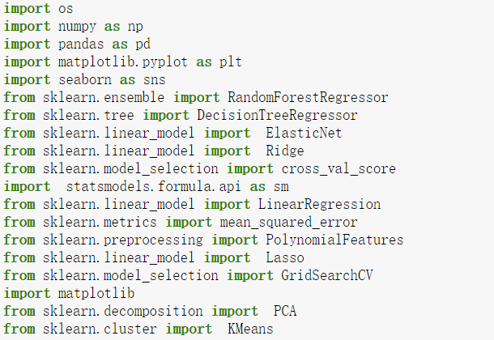
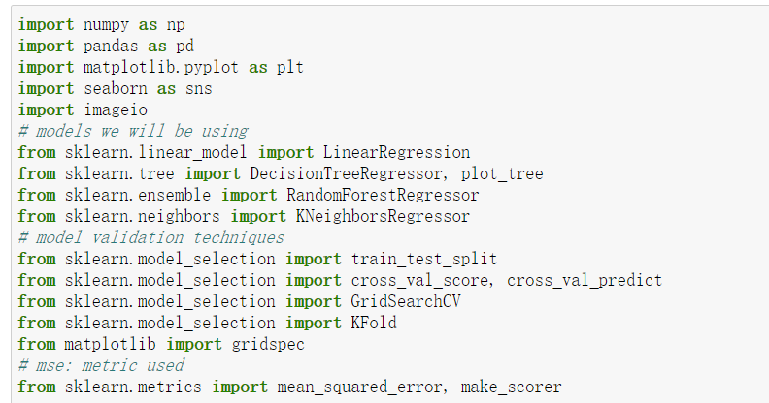
Import Libraires and resources
We use panda, numpy, sklearn, seaborn, matplotlib in ordre to help us process the dataset

Slide 5
So we want to do a prediction of obesity levels by using eating habits and physical condition data.
Let’s begin!

Slide 6
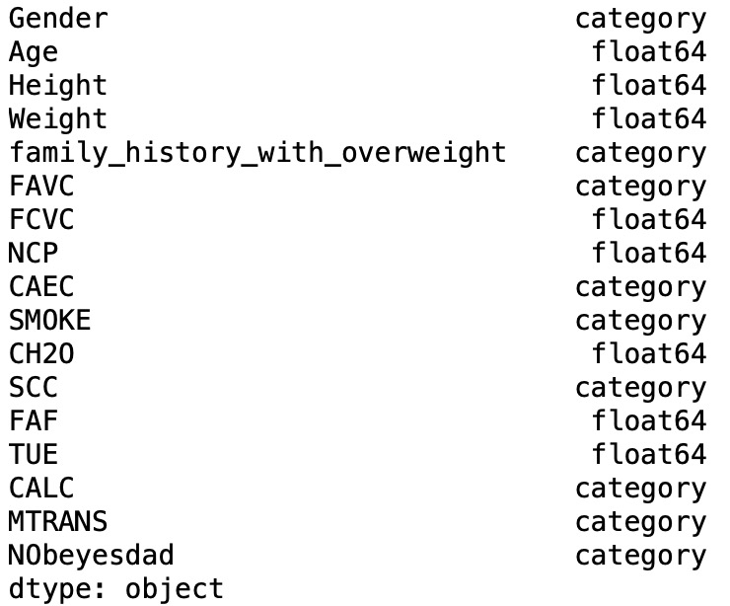
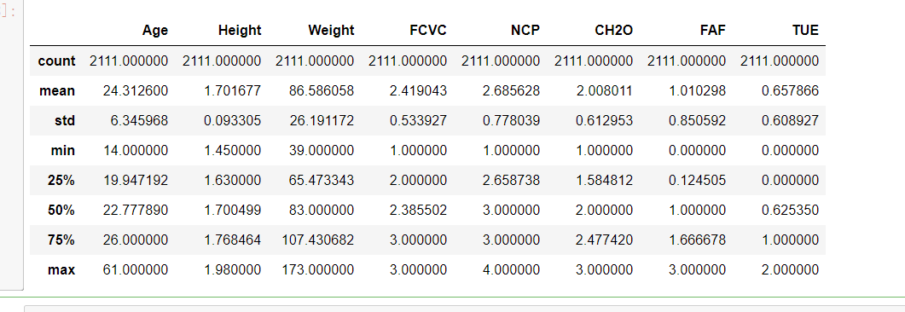
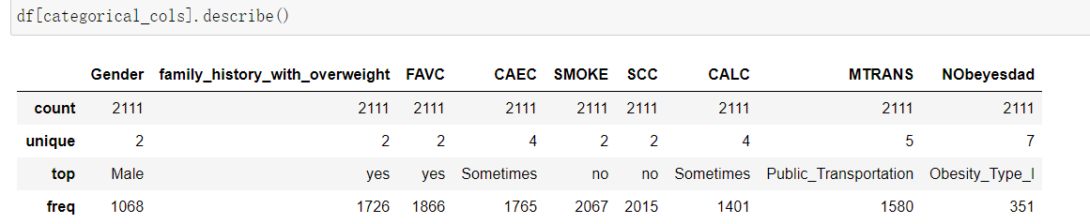
Check the dataset
We check the dataset and find out the dataset have float and category types data, and no missing values in the dataset which is not bad for our study.Also we can see for this test ,average age is very young

Slide 7
Data visualization
Histogramme,
Correlation matrix,
Univariate analysis,
Multivariate analysis

Slide 8
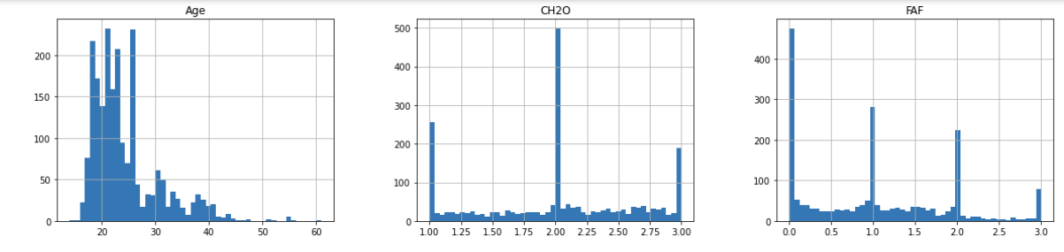
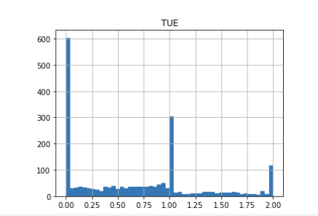
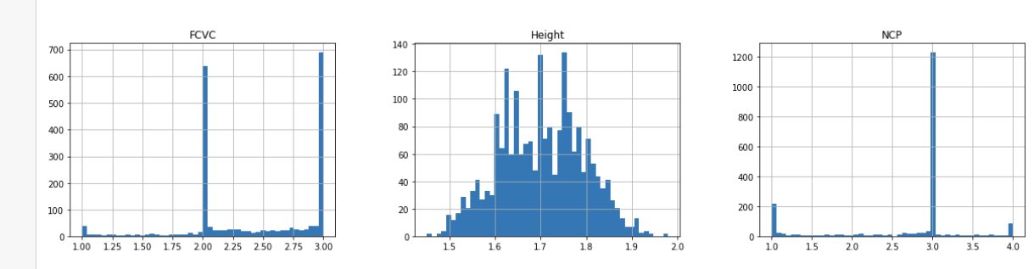
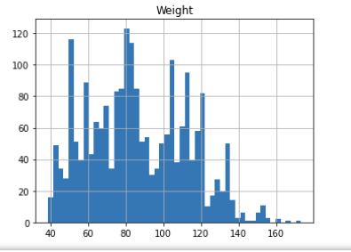
Histogramme
We can see those tester mainly are 20-30 years old, about 1/4 of people rarely do excerises, but most of the people eat a lot vegetables, most people eat 3 meals per day.
As for time using technology devices is like average ,about a little more than 1/3 seldom use it,1/3 use them ordinary and the other use it a lot.

Slide 9
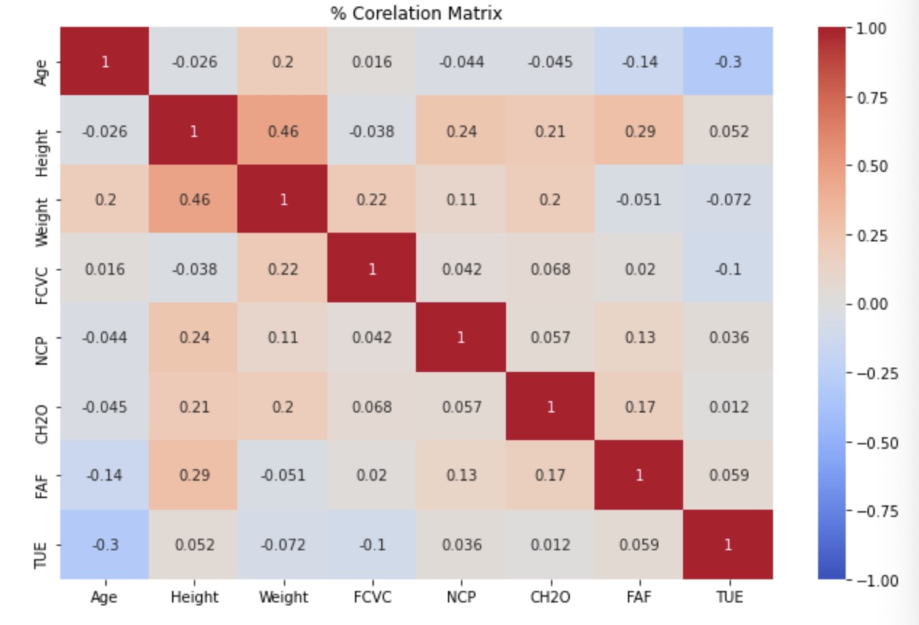
Correlation Matrix
1.From this matrix we can tell the connection between those different variantes.
2.The feature ‘height’ and ‘weight’ actually have a stronger connection to other variates compare to the rest variates

Slide 10
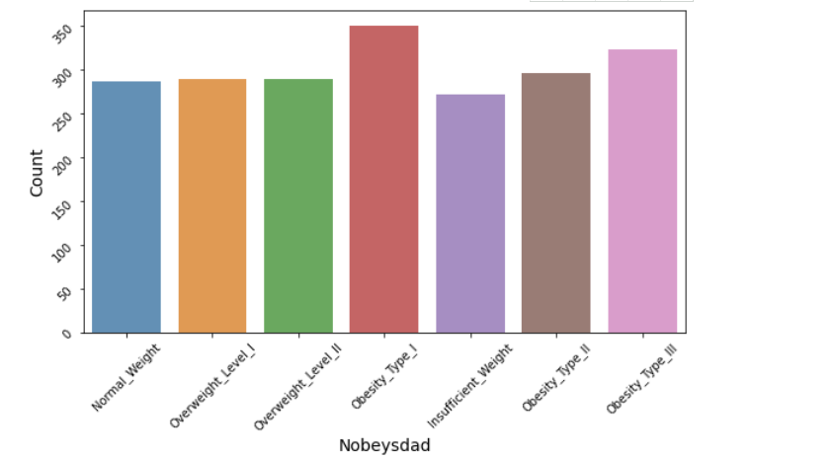
Univariate analysis
Its just simply a plot to count the number of each obesity level, we can find out each category have a very similar number
which indicate this dataset is a very good dataset in labeling.

Slide 11
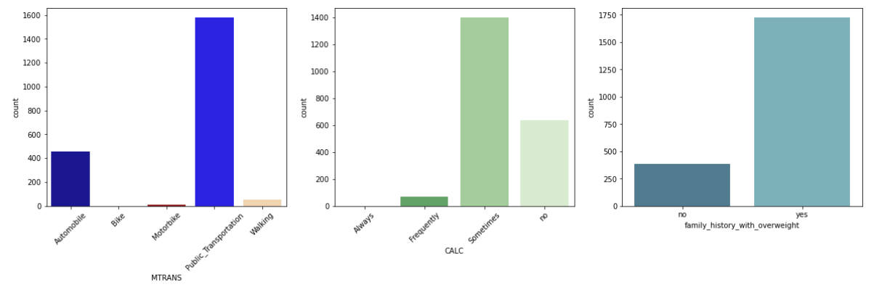
Univariate analysis
1.About 75% of people use Public transportation.
2.About 66% of people have a drink sometimes(a normal frequency).
3.About 82% of people have a family history with overweight.

Slide 12
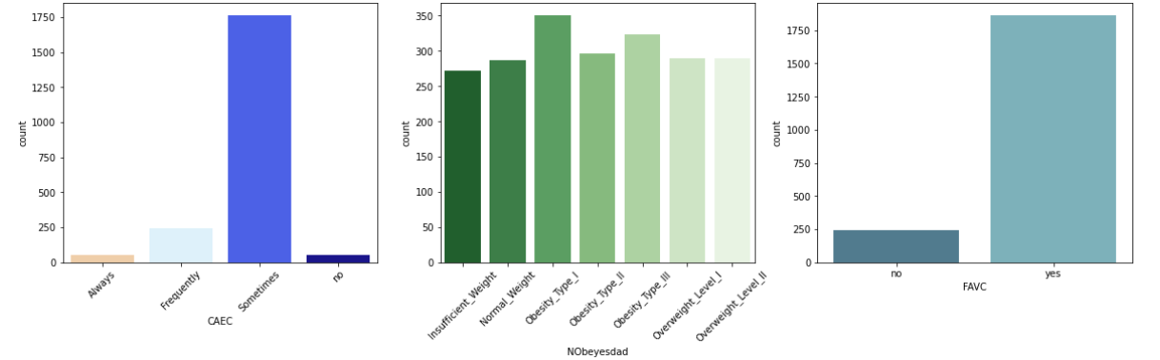
Univariate analysis
1.About 80% of people sometimes have consumption of food between meals.(CAEC)
2.About 75% of people eat high caloric food sometimes(a normal frequency)(FAVC).

Slide 13
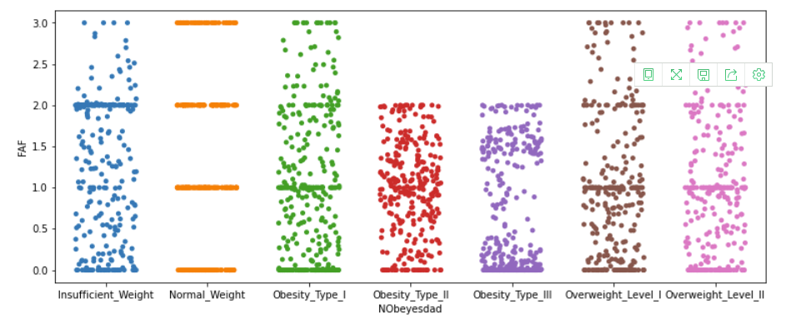
Single variante
Here we use ‘striplot’ from ‘seaborn’ to visualize single variante, this is the plot of FAF(Physical activity frequency),we can tell that FAF have no special connection or at least haver no simple connection to obesity because for most of people no matter they workout a lot or absolutely not ,they can still be insufficient weight or overweight

Slide 14
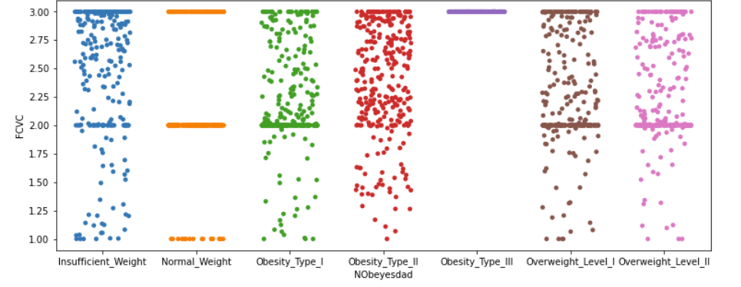
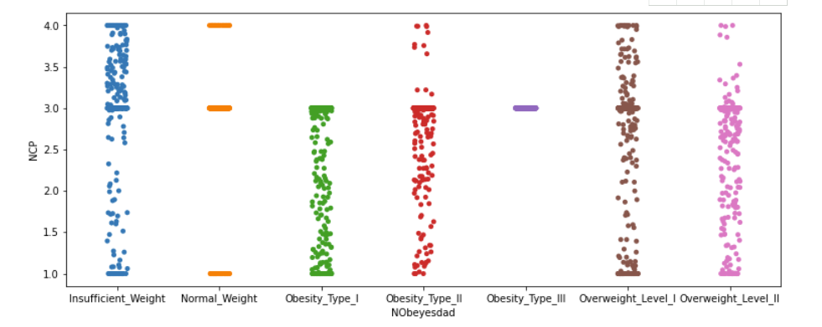
so same resulat as the previous one ,we can also find that out come in coleration matrix

Slide 15
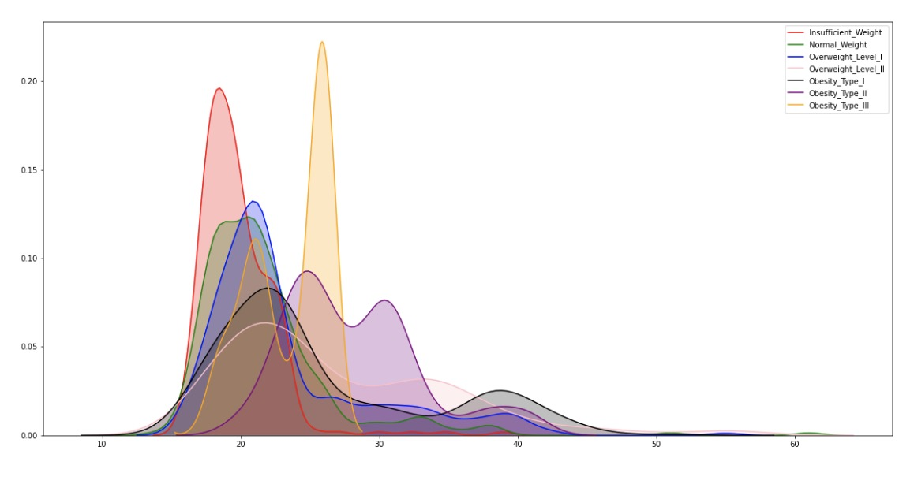
This is a density plot for age, we can tell at the age of 15-25, there is a high chance of insufficient weight probably because we are still growing and some might be growing a little slower than others, and at age 25-30, there is a high chance of super obesity.

Slide 16
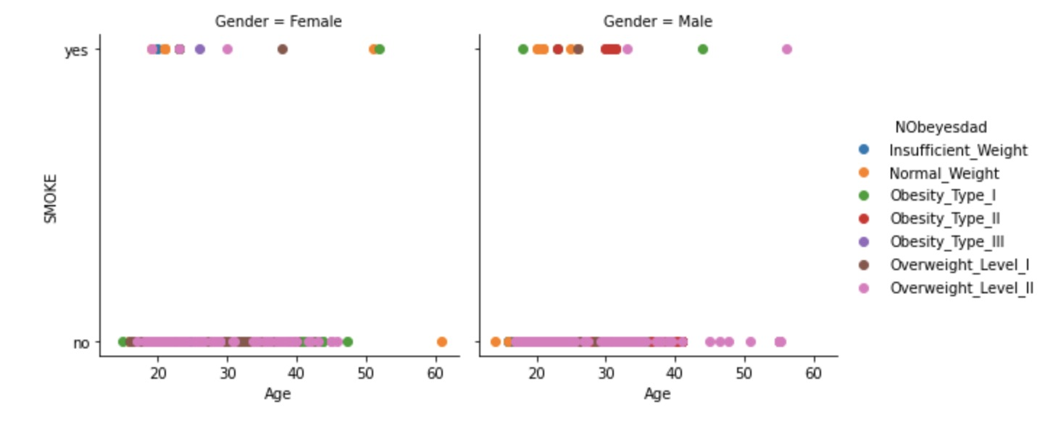
Multivariate analysis
Here we use ‘seaborn FaceGrid’ to analysis 3 different variates which are Smoke,Age and Gender and we find out most of the Overweight_Level_II dont smoke, at appears on all the the range of ages

Slide 17
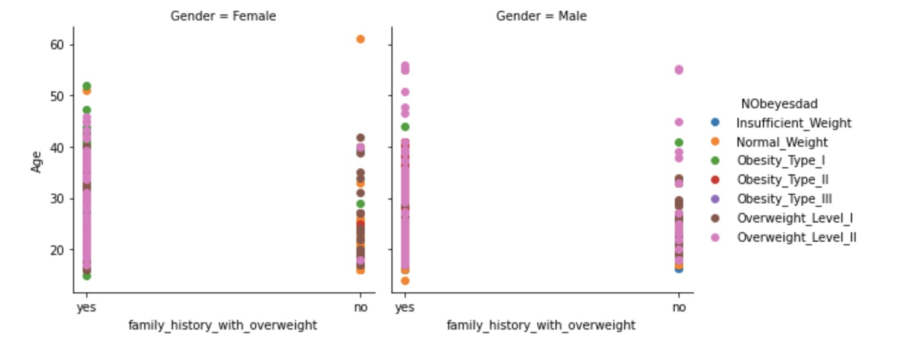
Multivariate analysis
Here we analysis 3 different variates which are family_history_with_overweight,
Age and Gender and we find out most of the people who have family overweight history have a higher chance to be overweight

Slide 18
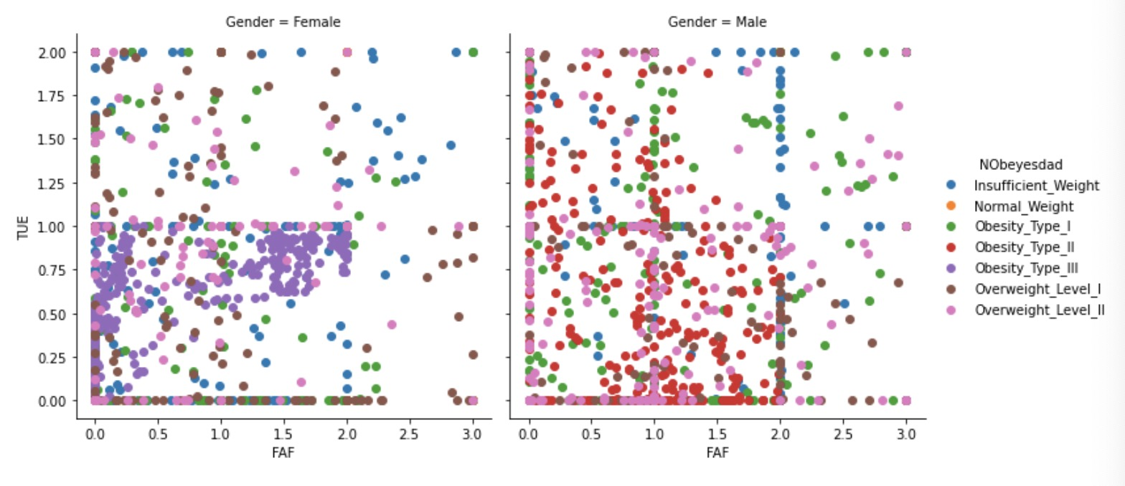
Multivariate analysis
Here we analysis 3 different variates which are FAF,Gender and TUE, so we can tell for either Female and Male, if TUE is lower than 1 and FAF lower than 2, people are more likely to have an overweight problem.

Slide 19
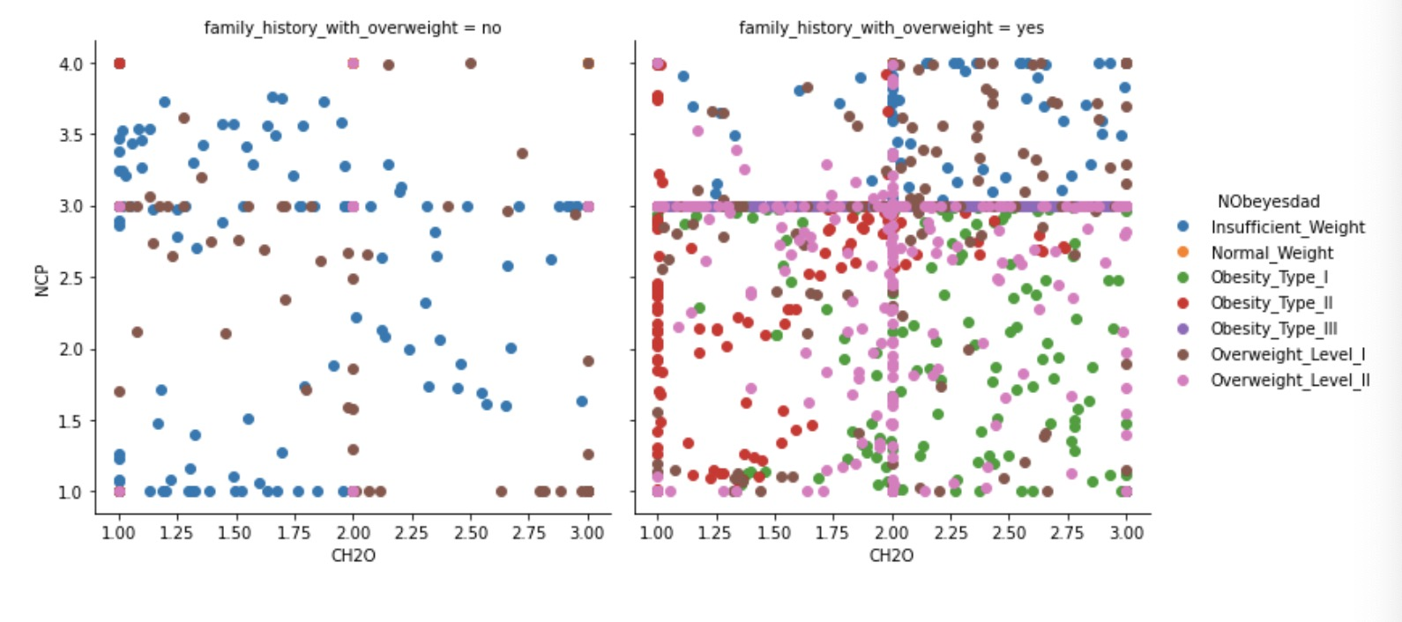
Multivariate analysis
Here we analysis 3 different variates which are NCP,CH2O and family history with overweight,so we can tell most people who dont have overweight history are not likely to have a overweight problem, and for people who drink 2 litre water per day and eat 3 meals per day are likely to have a overweight problem.

Slide 20
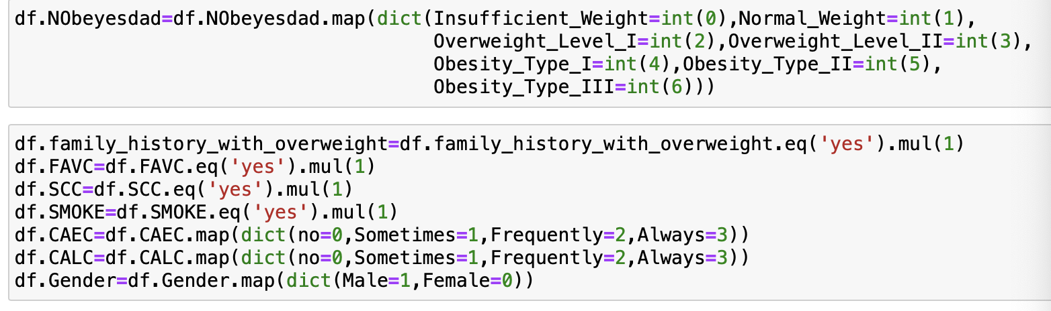
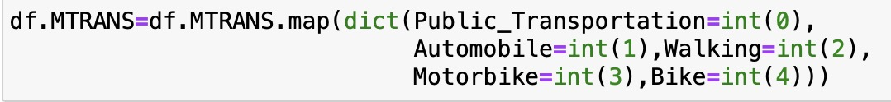
Data preprocessing
Label processing(Here we transfer our category feature to numbers.)
We consider the 0-6 which represent the obesity level.

Slide 21
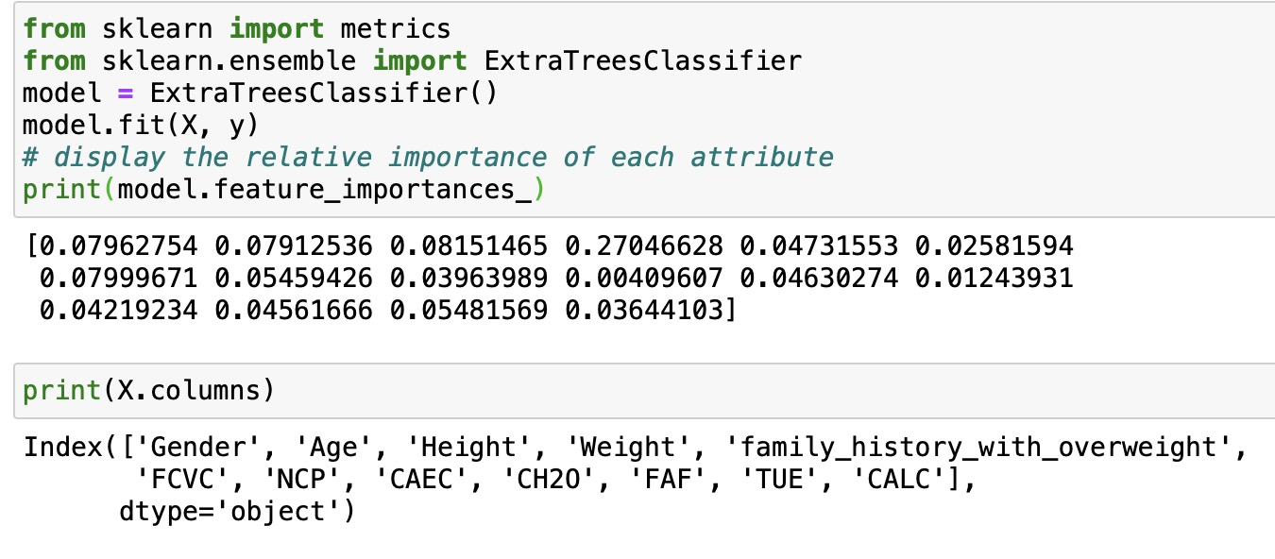
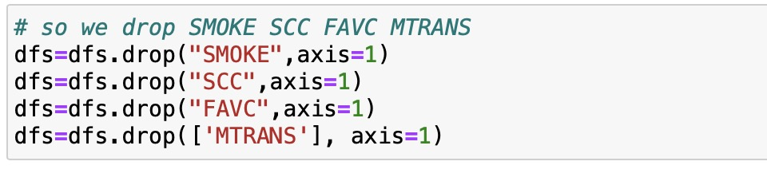
Choose the feature
We have 16 features, we want to choose most important features to train our model.We can find that the feature:SMOKE,SCC,FAVC,MTRANS have lower importance than others, so we drop it.

Slide 22

Split the data
We split the dataset into training data and test data by 0.3 which means 30% test data and 70% training data.

Slide 23
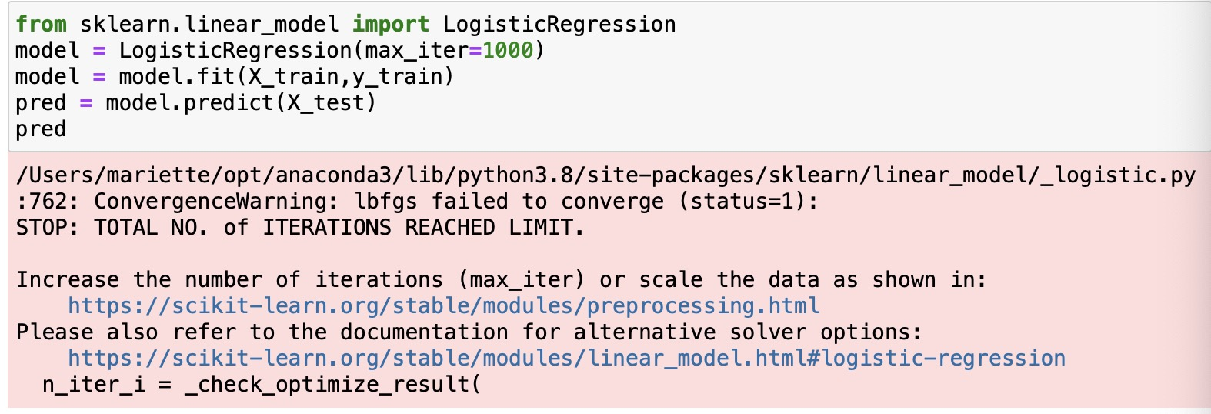
Modeling
Logistic Regression
So we simply using logistic regression first, ‘sklearn’ provide very good logistic regression, we here set ‘max_iter’ to 1000 in ordre to have a higher accuracy

Slide 24
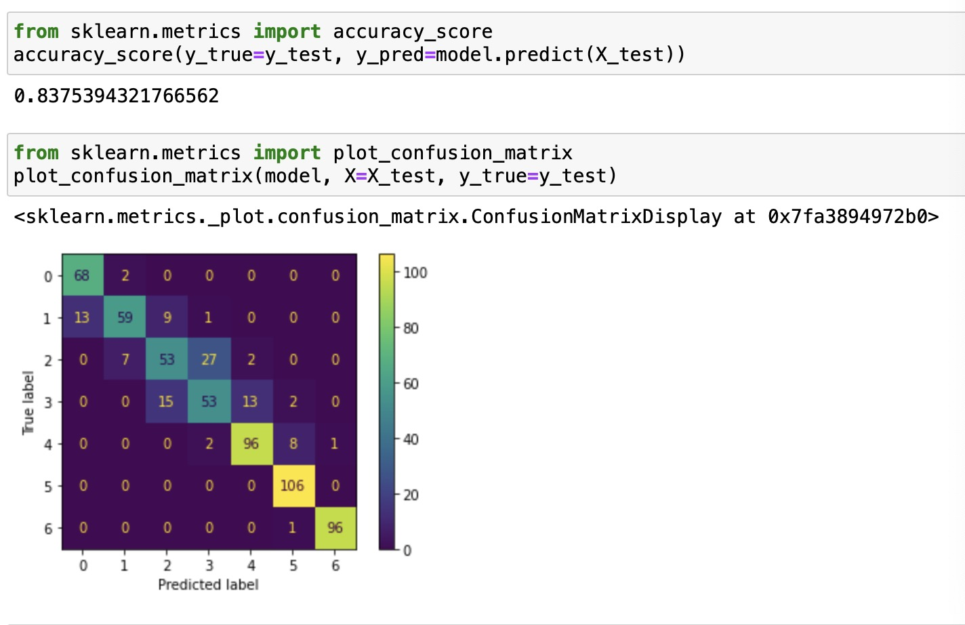
Logistic Regression
We can see the accuracy is about 80.4% and here is the confusion matrix, so we can see problems are most likely in level 0-4, actually logistic regression doesn’t have a very good performance here

Slide 25
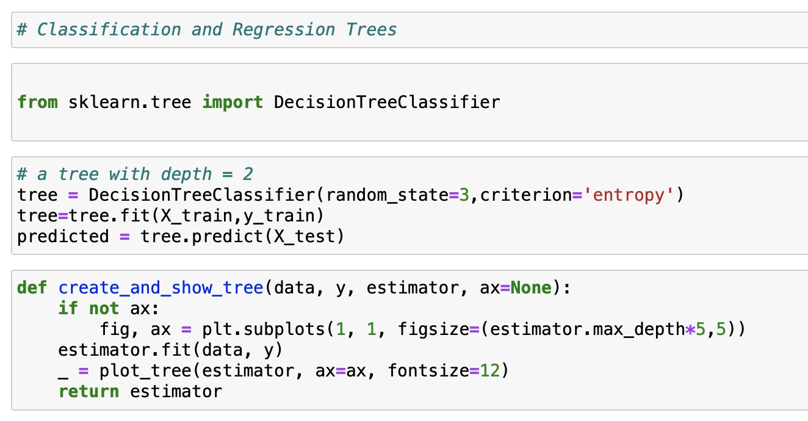
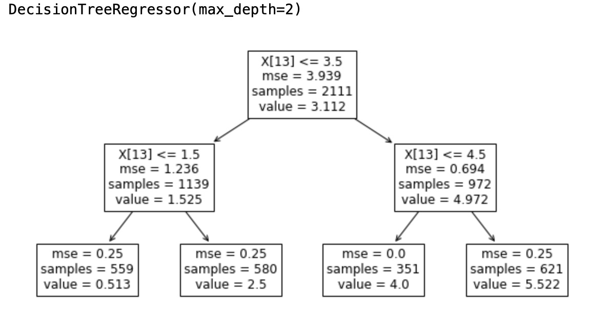
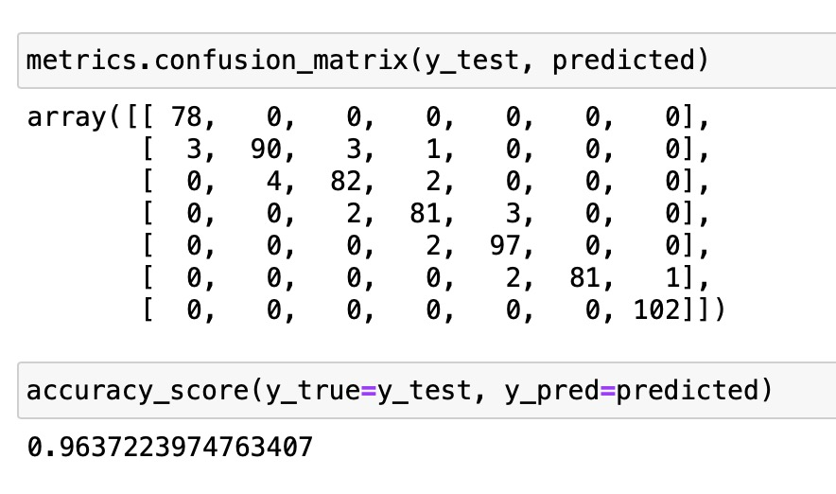
Classification Decision Tree

Slide 26
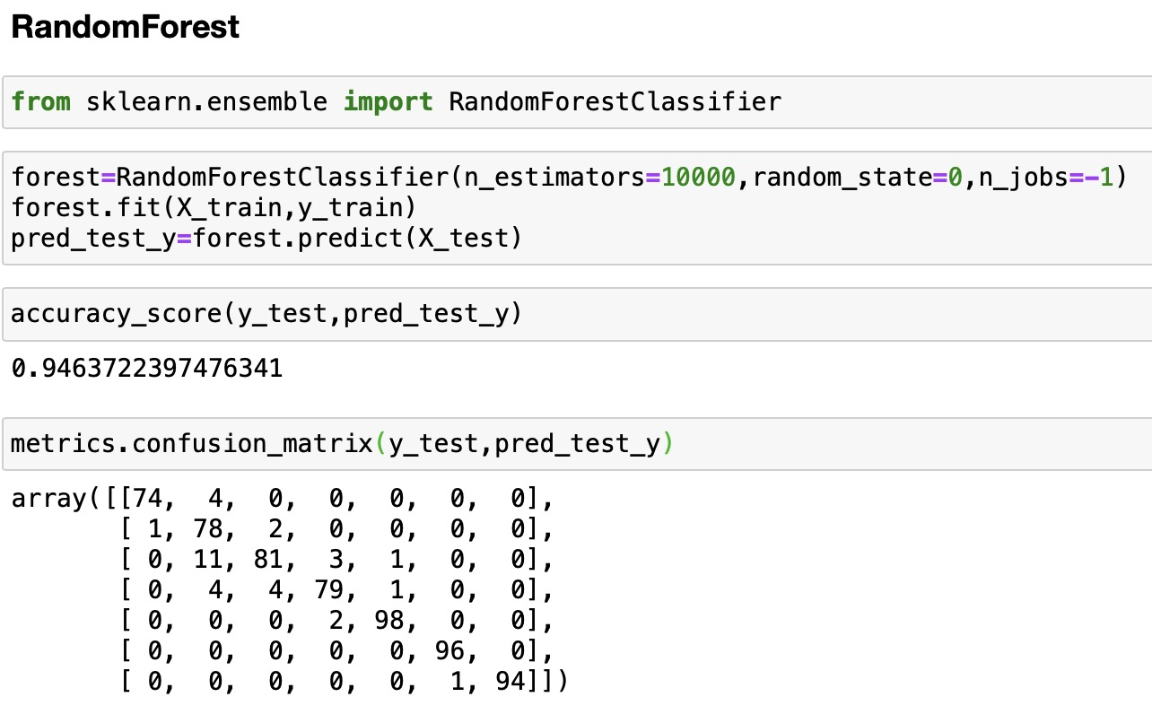
Randomforest
Using sklearn random forest consider our PC cpu, we set 10000 tree, and set random seed as 0, use all our cpu to calculate and predict the outcome
As our expectation ,random-forest give us the best outcome so far with a nearly 95.5% accuracy, we actually set
different seed to calculate several times and the outcome is between 94%-96%.

Slide 27
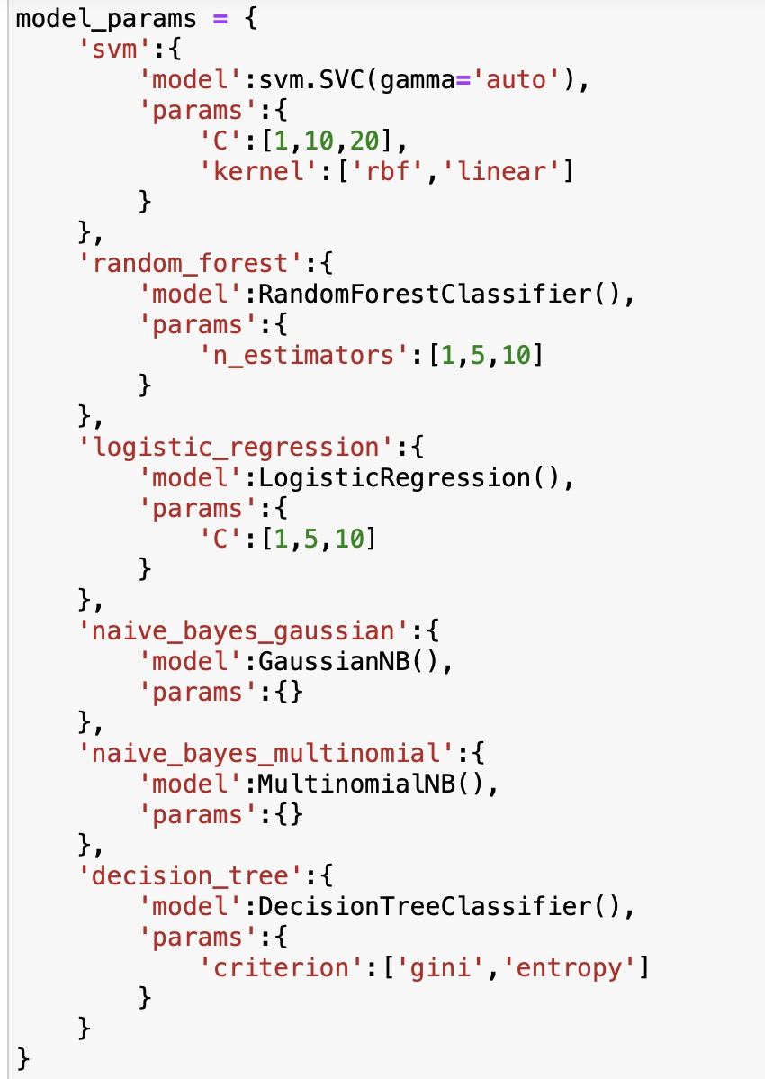
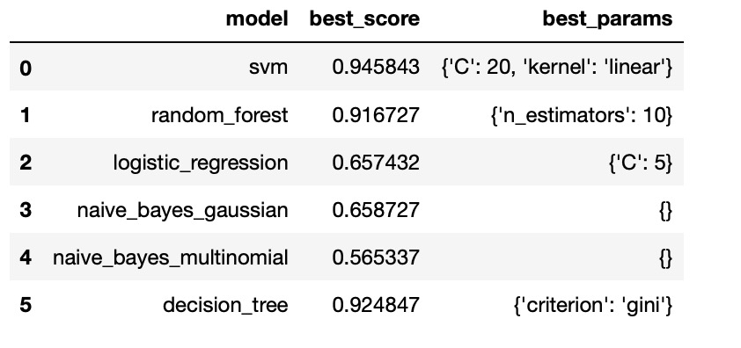
GridSearch
Use GridSearchCV to compare the effects of different models and different parameters on the experimental results.

Slide 28
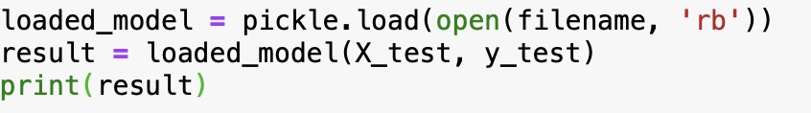
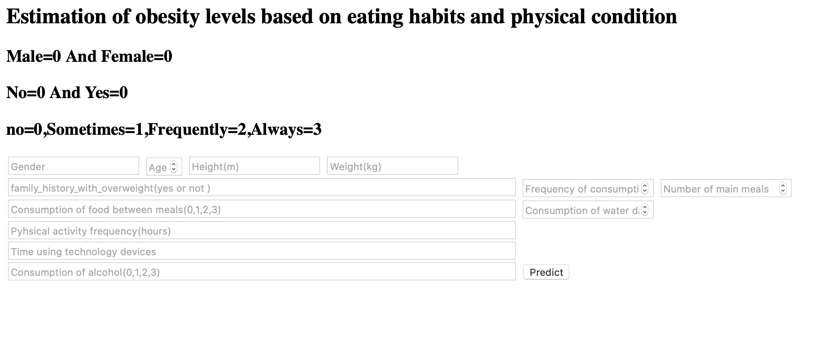
Transfer our dataset to Flask
We use pickle to save our model in order to use in the Flask
And we create a web where you can test your obesity level by enter your data(your habit). And you can test many times

Slide 29
Conclusion
By doing this analysis, we can know that our eating habits and physical condition is very important to our health, it can influence our obesity level. People who have lower calorie food, always do physical exercises, drink more water can have a healthier obesity level.
Thanks you for your attention.

